Slide 1
Multimodal Hate Speech Detection Ranked Signals

Slide 2
2022-2024

Slide 3
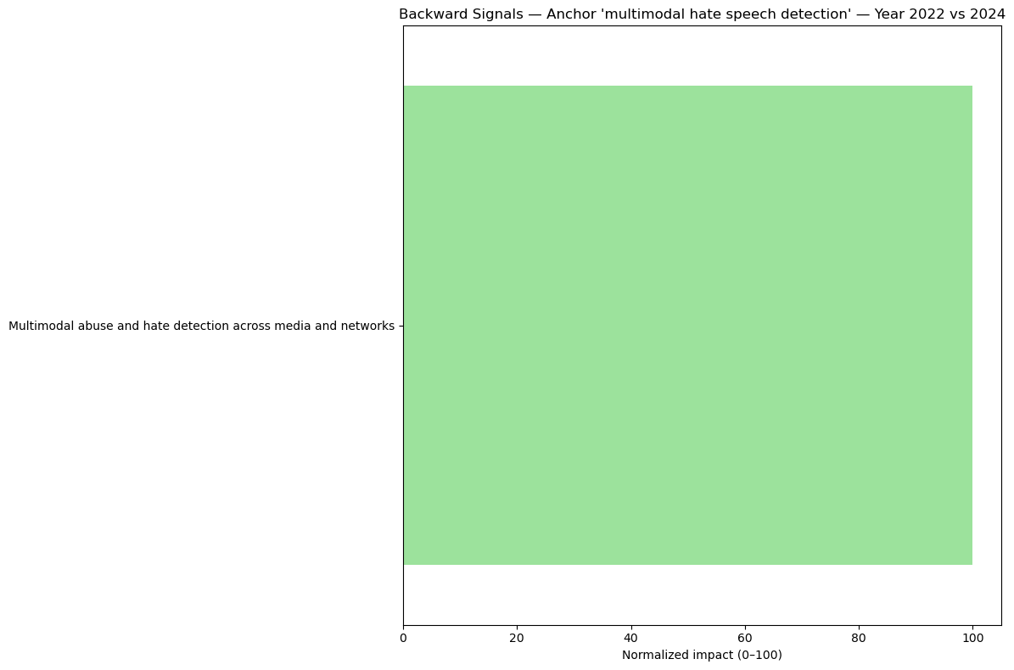

Slide 4
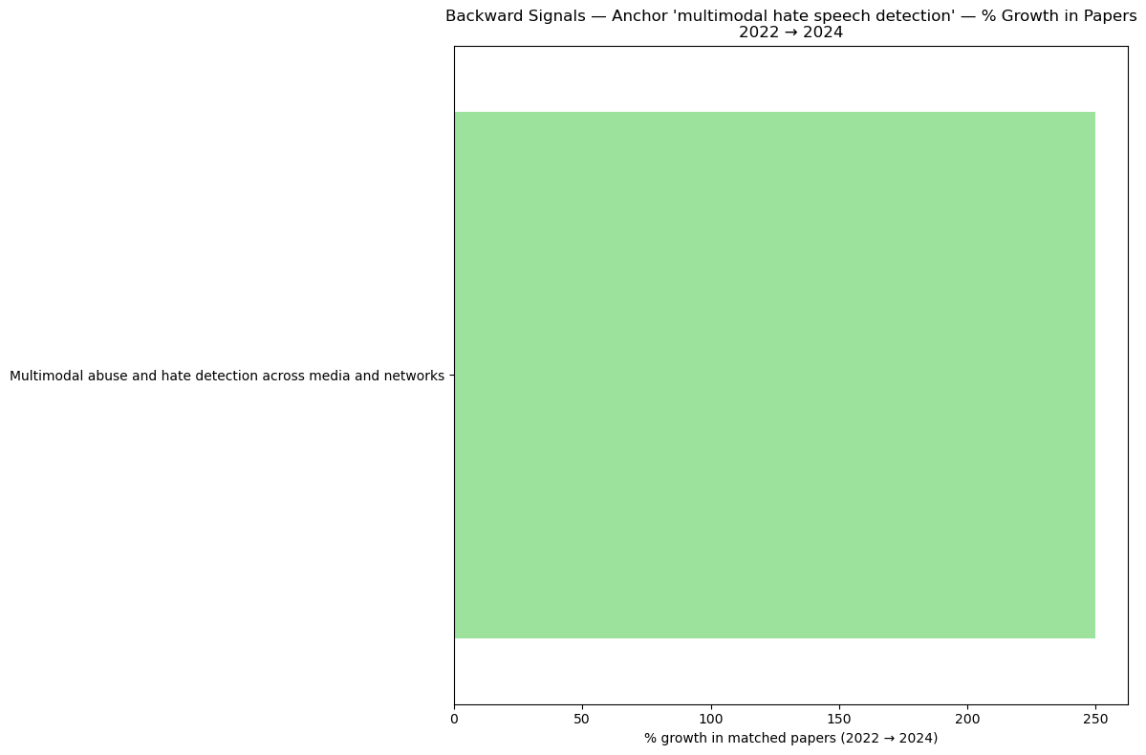

Slide 5
2020-2024

Slide 6
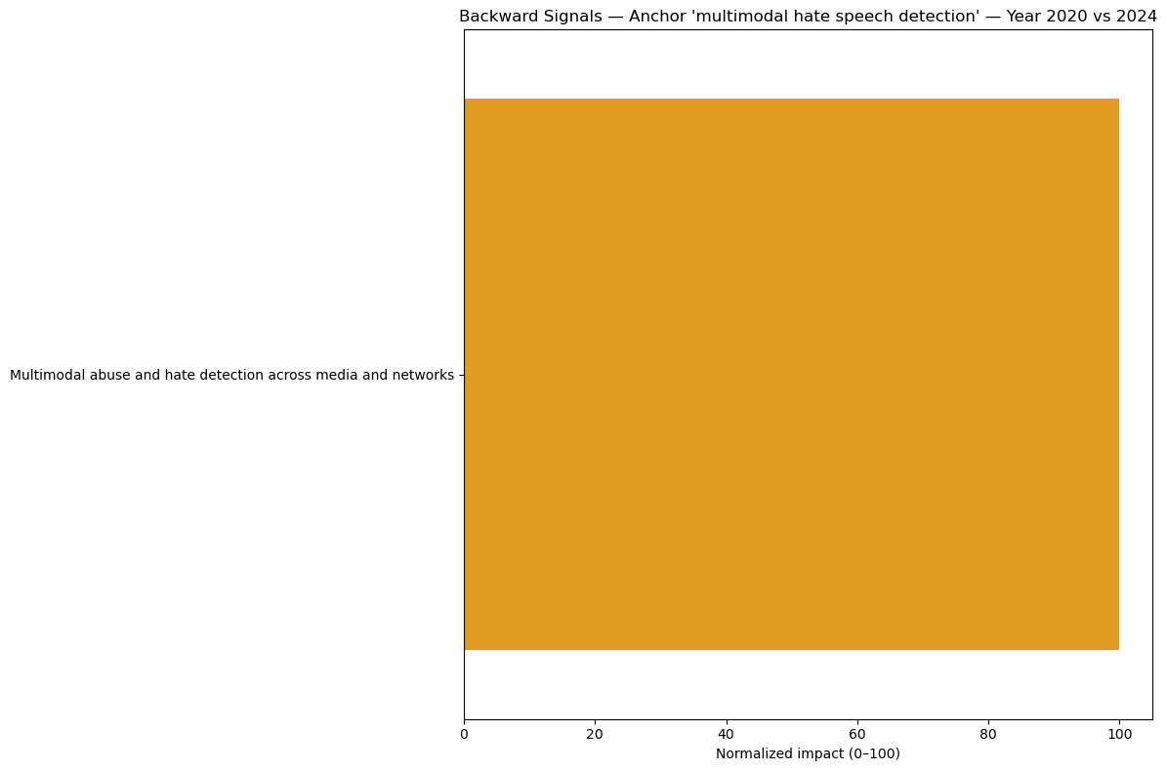

Slide 7
